Slide 1
Encrypted databases frontiers and prospects
Leqian ZHENG, 2022-Aug-19
Notes:
作为保障数据生产资料的安全基石，构建一个安全可靠的加密数据库系统有着十分重要的战略意义。可搜索加密技术，作为最相关的一类密码学原语，是该安全系统研发道路上的一个重要组成部分，为数据安防保护奠定了重要的理论基础。近年来，随着可信硬件技术的发展，研究人员在探索加密数据库的技术手段上，从早期的纯密码学方案逐渐过渡到与可信硬件相结合的方向，拟借助可信硬件技术来构造功能和性能完备的潜在解决方案。本报告聚焦数据安全搜索、加密数据库技术等前沿领域，探讨加密数据库的发展现状，安全挑战，以及未来展望。

Slide 2
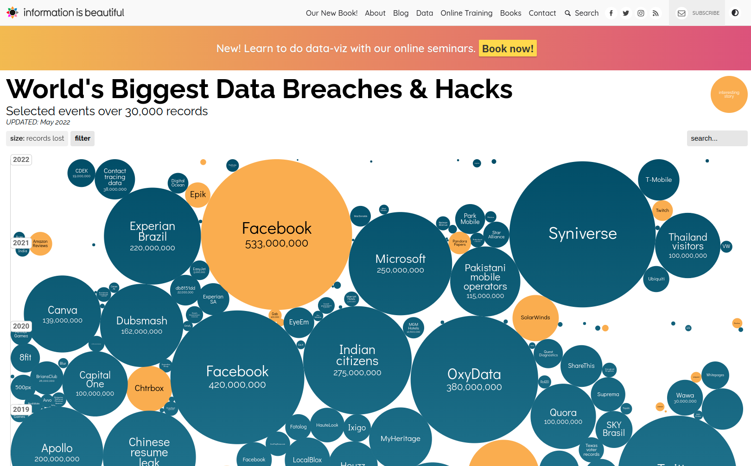
Data breach incidents are ever-growing

Slide 3
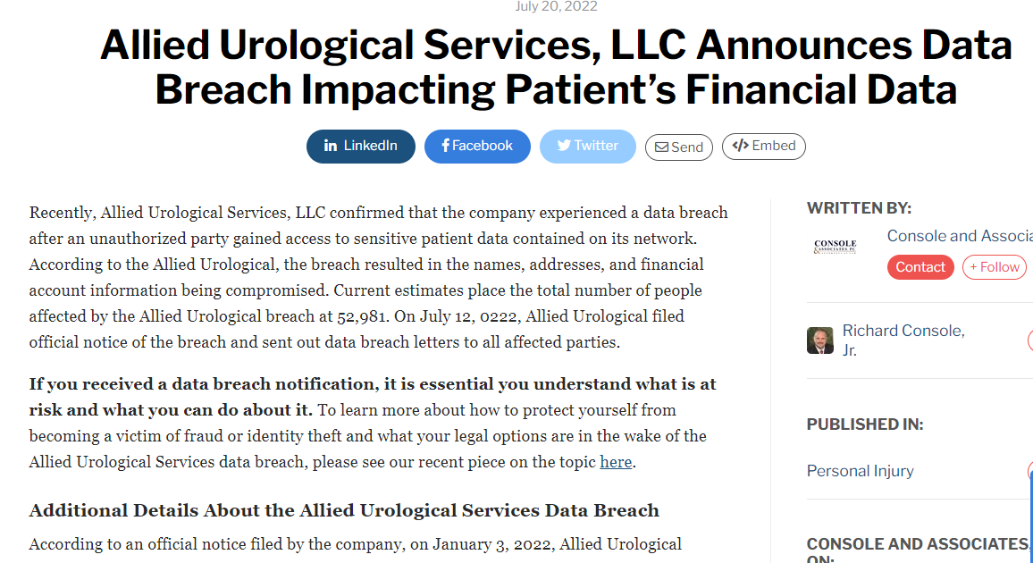
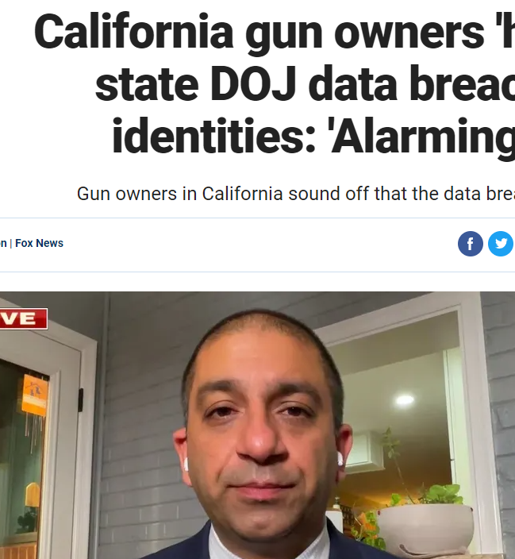
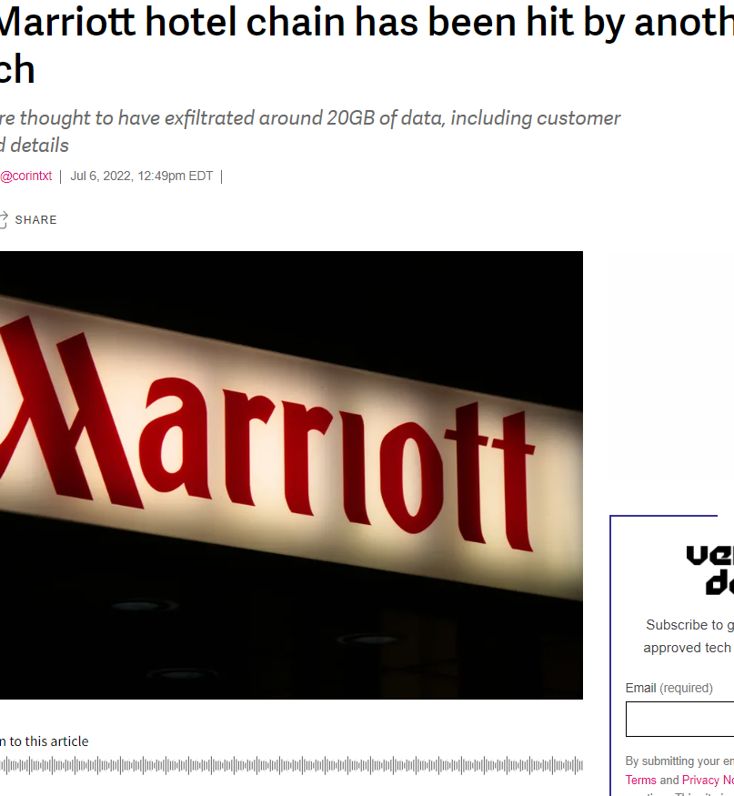
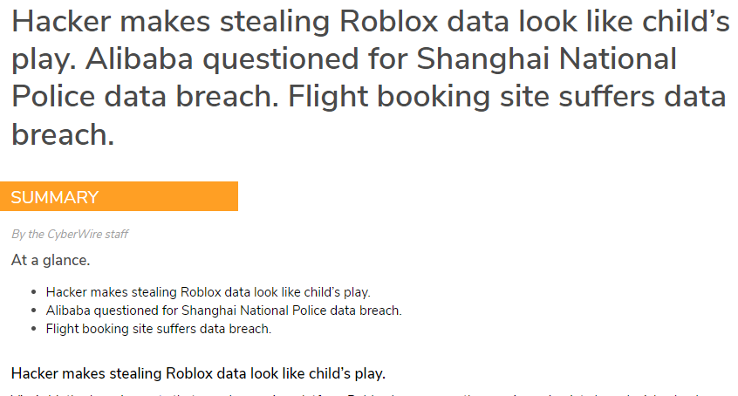
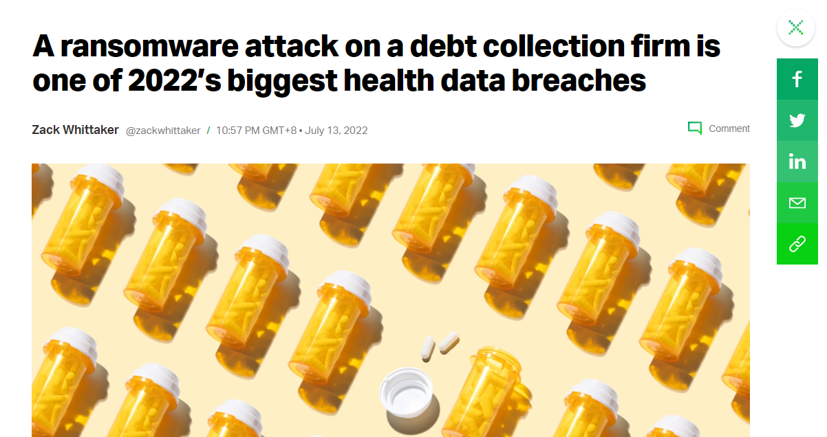
… even on a daily basis

Slide 4
However, in the face of massive data breaches,
13,782,581,211 records
…………………….
Only 4% were encrypted

Slide 5

Encryption is a must for in-depth defense

Slide 6
Data encryption through its lifecyle
 | Data in Transit | Data at Rest | Data in Use
Active Place | Complex network | External storage | Memory, bus, and cache
Potential Risks | Untrusted ISPs, routers | Physical or digital accesses | Administrator, co-tenants, insiders
Protections | Secure communication protocols, e.g., SSL/TLS, HTTPS | Symmetric cipher, e.g., AES, IDEA | Multi-Party Computation (MPC) Homomorphic Encryption (HE) Trusted Execution Environment (TEE) Encrypted Databases (EDB) Encrypted Search Algorithms (ESA) …
The focal point today

Slide 7
Approaches to protect data in use
Cryptographic Primitives
Instances
MPC
HE
ESA
EDB
…
Require sophisticated constructions
Some of them consume a lot of computation, storage, or communication resources; some have pessimistic information leakage

Slide 8
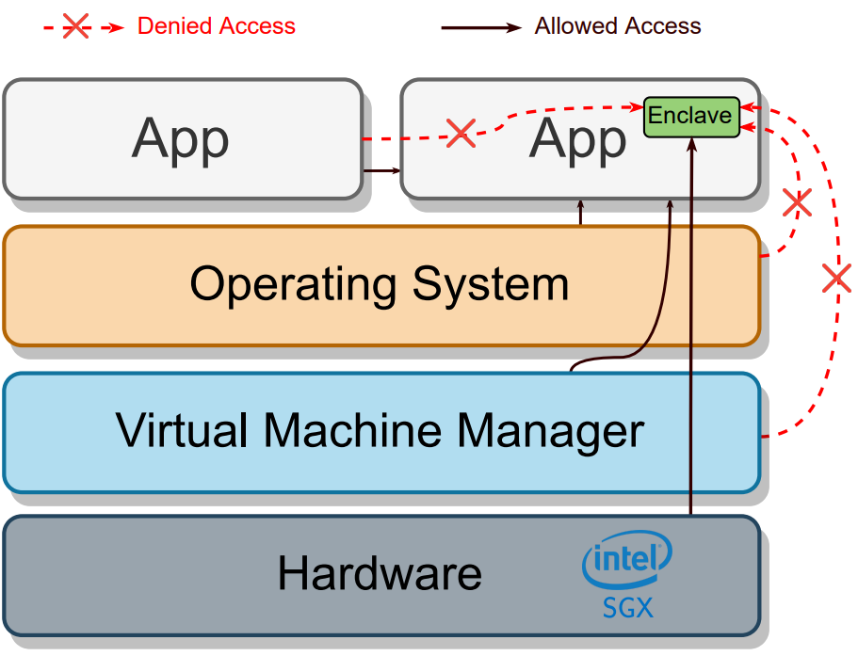
Approaches to protect data in use
Cryptographic Primitives
Trusted Execution Environment
Intel SGX Architecture
A reserved memory region (EPC) only accessibly by the enclave
≤ 256MB in 10th Gen client processors
≤ 512GB in 3rd Gen Xeon Server processors
Provide data confidentiality and integrity
Other TEE vendors
AMD Secure Encrypted Virtualization
ARM TrustZone
IBM Secure Execution
…
Trusted
Under attack

Slide 9
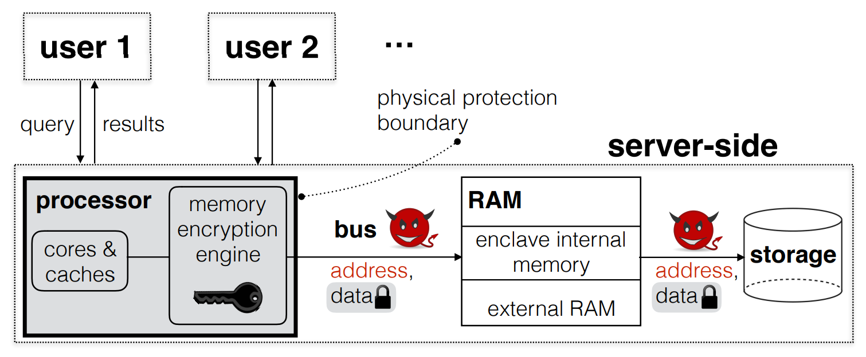
Limitations on Intel SGX
Security
Enclaves are not oblivious^{[1, 2, 3]}
The evolving arm race on breaking/securing the enclaves
Stacco (CCS’17), Foreshadow (USENIX Security’17), SgxPectre (EuroS&P’19), ZombieLoad (CCS’19), Plundervolt (S&P’20), …
[1] P. Mishra, R. Poddar, J. Chen, A. Chiesa and R. A. Popa, "Oblix: An Efficient Oblivious Search Index," 2018 IEEE Symposium on Security and Privacy (SP), 2018, pp. 279-296.
[2] J. Van Bulck, et al. Telling Your Secrets without Page Faults: Stealthy Page Table-Based Attacks on Enclaved Execution. In USENIX Security Symposium, 2017.
[3] W. Zheng, et al. Opaque: An Oblivious and Encrypted Distributed Analytics Platform. In NSDI 2017

Slide 10
Limitations on Intel SGX
Security
Performance
Context switch between the host and enclave (ECall / OCall) costs
Page swapping due to limited EPC capacity
App
Enclave
Trusted
ECall
OCall
Untrusted

Slide 11


Query encrypted data
Security
Performance
Functionalities
Focus on encrypted databases

Slide 12
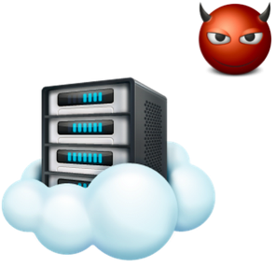


Encrypted database illustration
Untrusted Server
Client
Setup by outsourcing encrypted data

Slide 13
Encrypted database illustration
Untrusted Server
Client

Slide 14


Encrypted database illustration
Untrusted Server
Client
Encrypted query

Slide 15
A general threat model
Snapshot adversaries^{[1, 2, 3]}
An image of the virtual machine executing the DBMS
Rootkitting the OS
Data breaches
[1] Paul Grubbs, Richard McPherson, Muhammad Naveed, Thomas Ristenpart, and Vitaly Shmatikov. Breaking web applications built on top of encrypted data. In CCS, 2016.
[2] Kevin Lewi and David J Wu. Order-revealing encryption: New constructions, applications, and lower bounds. In CCS, 2016.
[3] Rishabh Poddar, Tobias Boelter, and Raluca Ada Popa. Arx: A strongly encrypted database system. Cryptology ePrint Archive, Report 2016/591, 2016.

Slide 16
A general threat model
Snapshot adversaries^{[1, 2, 3]}
An image of the virtual machine executing the DBMS
Rootkitting the OS
Data breaches
Persistent (passively-observing) adversaries^{[1]} – stronger
Curious-but-honest cloud service providers
Technical staffs (as individuals) to draw illegal benefits
Powerful hackers via privilege escalation
[1] P. Grubbs, et al. Why Your Encrypted Database is not secure. In HotOS 2017.

Slide 17

The field has grown tremendously
Lots of results based on pure cryptographic primitives
Support certain primitive operations for database queries
Exhibit leakage profiles that can be (sometimes highly) exploitable
Recent studies have shifted to designs leveraging secure hardware enclaves
Support common database workloads with good performance
Open a broad space of possible design choices, with many challenges

Slide 18
The field has grown tremendously
Lots of results based on pure cryptographic primitives
Support certain primitive operations for database queries
Exhibit leakage profiles that can be (sometimes highly) exploitable
Recent studies have shifted to designs leveraging secure hardware enclaves
Support common database workloads with good performance
Open a broad space of possible design choices, with many challenges
No dominant solution!

Slide 19
In this talk
Overview the latest advancements
Zoom into the potential obstacles
Discuss the possible roadmap ahead
Towards practically more secure, efficient
and functional encrypted databases

Slide 20
The Evolution of EDBs
PRZB11-CryptDB, VGG19-StealthDB
Crypto primitives
Mathematical foundations
Designs offering basic protections
Non-intrusive
Trusted Hardware
Better performance and functionalities

Slide 21
The Evolution of EDBs
PRZB11-CryptDB, VGG19-StealthDB
Crypto primitives
Mathematical foundations
Designs offering basic protections
Non-intrusive
IKK12, NKW15, KKNO16
Trusted Hardware
Attacks exhibit extremely high risks against snapshot adv
Better performance and functionalities
Protections against snapshot adversaries
PVC⁺18-EnclaveDB, PBP19-Arx, AAS+20-AzureAE

Slide 22
The Evolution of EDBs
PRZB11-CryptDB, VGG19-StealthDB
Crypto primitives
Mathematical foundations
Designs offering basic protections
Non-intrusive
IKK12, NKW15, KKNO16
Trusted Hardware
Attacks exhibit extremely high risks against snapshot adv
Better performance and functionalities
(G)LMP18, GJW19, BKM20, KPT20, OK21
Protections against snapshot adversaries
Leakage-abuse attacks exploiting access pattern (plus other leakage)
PVC⁺18-EnclaveDB, PBP19-Arx, AAS+20-AzureAE
Full protections against persistent adversaries
ZDB⁺17-Opaque, MPC⁺19-Oblix
HOJY19-POSUP, EZ19-ObliDB

Slide 23
The Evolution of EDBs
PRZB11-CryptDB, VGG19-StealthDB
Crypto primitives
Mathematical foundations
Designs offering basic protections
Non-intrusive
IKK12, NKW15, KKNO16
Trusted Hardware
Attacks exhibit extremely high risks against snapshot adv
Better performance and functionalities
(G)LMP18, GJW19, BKM20, KPT20, OK21
Protections against snapshot adversaries
Leakage-abuse attacks exploiting access pattern (plus other leakage)
PVC⁺18-EnclaveDB, PBP19-Arx, AAS+20-AzureAE
KKNO16, GLMP18
Future directions
Concrete requirements (lower bounds) for attacks
Full protections against persistent adversaries
Recent attempts to balance security and performance
Theoretically and empirically unscalable
ZDB⁺17-Opaque, MPC⁺19-Oblix
HOJY19-POSUP, EZ19-ObliDB
GKL⁺20-Pancake
XDZ⁺21, SOPK21^
SWLL21-Enclage
VBKA22-Shortstack
GO96, EZ19-ObliDB

Slide 24
Designs offering basic protections
CryptDB^{[1]} adopts SQL-aware encryption schemes
Deterministic encryption for equality checks
Oder preserving encryption for order-related queries
Semantically secure encryption encapsulates the above ciphertexts
It will be stripped when necessary
Homomorphic encryption for arithmetic operations
[1] Popa. R. etl al. CryptDB: A Practical Encrypted Relational DBMS. SOSP 2011

Slide 25
CryptDB: an example
Encryption process – client-side
plaintext
DET
OPE
HOM
RND(DET)
RND(OPE)
HOM
salary
60
100
800
100
salary_onion1 | salary_onion2 | salary_onion3
x934bc1 | x1eab81 | 7fp35ixipc92…ob1
x5a8c34 | x638e54 | xp2kshf8gefn…4a1
x84a21c | x922eb4 | lu13iiiqlby2…x22
x5a8c34 | x638e54 | q76k8mt7v10c…nv4
salary_onion1 | salary_onion2 | salary_onion3
x4be219 | pubtzg8e | 7fp35ixipc92…ob1
x95c623 | mk3o3o4w | xp2kshf8gefn…4a1
x2ea887 | amri5idd | lu13iiiqlby2…x22
x17cea7 | y6plicde | q76k8mt7v10c…nv4
Popa. R. etl al. CryptDB: A Practical Encrypted Relational DBMS. SOSP 2011

Slide 26

CryptDB: an example
Encryption process – client-side
The cloud server
plaintext
DET
OPE
HOM
RND(DET)
RND(OPE)
HOM
salary
60
100
800
100
salary_onion1 | salary_onion2 | salary_onion3
x934bc1 | x1eab81 | 7fp35ixipc92…ob1
x5a8c34 | x638e54 | xp2kshf8gefn…4a1
x84a21c | x922eb4 | lu13iiiqlby2…x22
x5a8c34 | x638e54 | q76k8mt7v10c…nv4
salary_onion1 | salary_onion2 | salary_onion3
x4be219 | pubtzg8e | 7fp35ixipc92…ob1
x95c623 | mk3o3o4w | xp2kshf8gefn…4a1
x2ea887 | amri5idd | lu13iiiqlby2…x22
x17cea7 | y6plicde | q76k8mt7v10c…nv4
Popa. R. etl al. CryptDB: A Practical Encrypted Relational DBMS. SOSP 2011

Slide 27
CryptDB: an example
Encryption process – client-side
The cloud server
plaintext
DET
OPE
HOM
RND(DET)
RND(OPE)
HOM
salary
60
100
800
100
salary_onion1 | salary_onion2 | salary_onion3
x934bc1 | x1eab81 | 7fp35ixipc92…ob1
x5a8c34 | x638e54 | xp2kshf8gefn…4a1
x84a21c | x922eb4 | lu13iiiqlby2…x22
x5a8c34 | x638e54 | q76k8mt7v10c…nv4
salary_onion1 | salary_onion2 | salary_onion3
x4be219 | pubtzg8e | 7fp35ixipc92…ob1
x95c623 | mk3o3o4w | xp2kshf8gefn…4a1
x2ea887 | amri5idd | lu13iiiqlby2…x22
x17cea7 | y6plicde | q76k8mt7v10c…nv4
Popa. R. etl al. CryptDB: A Practical Encrypted Relational DBMS. SOSP 2011

Slide 28
CryptDB: an example
Search process
Application
RND(DET)
RND(OPE)
HOM
salary_onion1 | salary_onion2 | salary_onion3
x4be219 | pubtzg8e | 7fp35ixipc92…ob1
x95c623 | mk3o3o4w | xp2kshf8gefn…4a1
x2ea887 | amri5idd | lu13iiiqlby2…x22
x17cea7 | y6plicde | q76k8mt7v10c…nv4
SELECT * FROM emp WHERE salary = 100
SELECT * FROM table1 WHERE col3 = x5a8c34
Proxy
Trusted
Untrusted
Popa. R. etl al. CryptDB: A Practical Encrypted Relational DBMS. SOSP 2011

Slide 29
CryptDB: an example
Search process
Application
DET
RND(OPE)
HOM
salary_onion1 | salary_onion2 | salary_onion3
x934bc1 | pubtzg8e | 7fp35ixipc92…ob1
x5a8c34 | mk3o3o4w | xp2kshf8gefn…4a1
x84a21c | amri5idd | lu13iiiqlby2…x22
x5a8c34 | y6plicde | q76k8mt7v10c…nv4
SELECT * FROM emp WHERE salary = 100
SELECT * FROM table1 WHERE col3 = x5a8c34
Proxy
The entire column will be reduced to DET
Trusted
Untrusted
Popa. R. etl al. CryptDB: A Practical Encrypted Relational DBMS. SOSP 2011

Slide 30
CryptDB: an example
Search process
Application
DET
RND(OPE)
HOM
salary_onion1 | salary_onion2 | salary_onion3
x934bc1 | pubtzg8e | 7fp35ixipc92…ob1
x5a8c34 | mk3o3o4w | xp2kshf8gefn…4a1
x84a21c | amri5idd | lu13iiiqlby2…x22
x5a8c34 | y6plicde | q76k8mt7v10c…nv4
SELECT * FROM emp WHERE salary ≥ 100
Proxy
Trusted
Untrusted
Popa. R. etl al. CryptDB: A Practical Encrypted Relational DBMS. SOSP 2011

Slide 31
CryptDB: an example
Search process
Application
DET
OPE
HOM
salary_onion1 | salary_onion2 | salary_onion3
x934bc1 | x1eab81 | 7fp35ixipc92…ob1
x5a8c34 | x638e54 | xp2kshf8gefn…4a1
x84a21c | x922eb4 | lu13iiiqlby2…x22
x5a8c34 | x638e54 | q76k8mt7v10c…nv4
SELECT * FROM emp WHERE salary ≥ 100
SELECT * FROM table1 WHERE col3 ≥ x638e54
Proxy
The entire column will be reduced to OPE
Trusted
Untrusted
Popa. R. etl al. CryptDB: A Practical Encrypted Relational DBMS. SOSP 2011

Slide 32
Frequency attack against CryptDB
Encrypted Column
Patient ID | #Days
Patient 1 | 467xt2J23t
Patient 2 | 467xt2J23t
Patient 3 | 42wBrfQ7yn
Patient 4 | 467xt2J23t
Patient 5 | fNewgCgM20
Patient 6 | 467xt2J23t
Patient 7 | 467xt2J23t
Patient 8 | 467xt2J23t
Patient 9 | zt1NEtbkn9
Patient 10 | 467xt2J23t
Patient 11 | 42wBrfQ7yn
Patient 12 | 467xt2J23t
Patient 13 | j0th0LeIsP
Patient 14 | 467xt2J23t
Patient 15 | zt1NEtbkn9
Patient 16 | 467xt2J23t
Patient 17 | 42wBrfQ7yn
Patient 18 | 467xt2J23t
Patient 19 | 467xt2J23t
Patient 20 | 42wBrfQ7yn
Number of days patient stays in hospital
Naveed M. et al. Inference Attacks on Property-Preserving Encrypted Databases. CCS 2015.

Slide 33
Frequency attack against CryptDB
Encrypted Column
Histogram
Patient ID | #Days
Patient 1 | 467xt2J23t
Patient 2 | 467xt2J23t
Patient 3 | 42wBrfQ7yn
Patient 4 | 467xt2J23t
Patient 5 | fNewgCgM20
Patient 6 | 467xt2J23t
Patient 7 | 467xt2J23t
Patient 8 | 467xt2J23t
Patient 9 | zt1NEtbkn9
Patient 10 | 467xt2J23t
Patient 11 | 42wBrfQ7yn
Patient 12 | 467xt2J23t
Patient 13 | j0th0LeIsP
Patient 14 | 467xt2J23t
Patient 15 | zt1NEtbkn9
Patient 16 | 467xt2J23t
Patient 17 | 42wBrfQ7yn
Patient 18 | 467xt2J23t
Patient 19 | 467xt2J23t
Patient 20 | 42wBrfQ7yn
#Days | Frequency
j0th0LeIsP | 1
42wBrfQ7yn | 4
467xt2J23t | 12
zt1NEtbkn9 | 2
fNewgCgM20 | 1
Number of days patient stays in hospital
Naveed M. et al. Inference Attacks on Property-Preserving Encrypted Databases. CCS 2015.

Slide 34
Frequency attack against CryptDB
Encrypted Column
Sorted Histogram
Patient ID | #Days
Patient 1 | 467xt2J23t
Patient 2 | 467xt2J23t
Patient 3 | 42wBrfQ7yn
Patient 4 | 467xt2J23t
Patient 5 | fNewgCgM20
Patient 6 | 467xt2J23t
Patient 7 | 467xt2J23t
Patient 8 | 467xt2J23t
Patient 9 | zt1NEtbkn9
Patient 10 | 467xt2J23t
Patient 11 | 42wBrfQ7yn
Patient 12 | 467xt2J23t
Patient 13 | j0th0LeIsP
Patient 14 | 467xt2J23t
Patient 15 | zt1NEtbkn9
Patient 16 | 467xt2J23t
Patient 17 | 42wBrfQ7yn
Patient 18 | 467xt2J23t
Patient 19 | 467xt2J23t
Patient 20 | 42wBrfQ7yn
#Days | Frequency
467xt2J23t | 12
42wBrfQ7yn | 4
zt1NEtbkn9 | 2
j0th0LeIsP | 1
fNewgCgM20 | 1
Number of days patient stays in hospital
Naveed M. et al. Inference Attacks on Property-Preserving Encrypted Databases. CCS 2015.

Slide 35
Frequency attack against CryptDB
Encrypted Column
Sorted Histogram
Sorted Auxiliary Histogram
Patient ID | #Days
Patient 1 | 467xt2J23t
Patient 2 | 467xt2J23t
Patient 3 | 42wBrfQ7yn
Patient 4 | 467xt2J23t
Patient 5 | fNewgCgM20
Patient 6 | 467xt2J23t
Patient 7 | 467xt2J23t
Patient 8 | 467xt2J23t
Patient 9 | zt1NEtbkn9
Patient 10 | 467xt2J23t
Patient 11 | 42wBrfQ7yn
Patient 12 | 467xt2J23t
Patient 13 | j0th0LeIsP
Patient 14 | 467xt2J23t
Patient 15 | zt1NEtbkn9
Patient 16 | 467xt2J23t
Patient 17 | 42wBrfQ7yn
Patient 18 | 467xt2J23t
Patient 19 | 467xt2J23t
Patient 20 | 42wBrfQ7yn
#Days | Frequency
467xt2J23t | 12
42wBrfQ7yn | 4
zt1NEtbkn9 | 2
j0th0LeIsP | 1
fNewgCgM20 | 1
#Days | Frequency
1 | 11
2 | 5
3 | 2
4 | 1
5 | 1
Number of days patient stays in hospital
Naveed M. et al. Inference Attacks on Property-Preserving Encrypted Databases. CCS 2015.

Slide 36
Frequency attack against CryptDB
Encrypted Column
Sorted Histogram
Sorted Auxiliary Histogram
Patient ID | #Days
Patient 1 | 467xt2J23t
Patient 2 | 467xt2J23t
Patient 3 | 42wBrfQ7yn
Patient 4 | 467xt2J23t
Patient 5 | fNewgCgM20
Patient 6 | 467xt2J23t
Patient 7 | 467xt2J23t
Patient 8 | 467xt2J23t
Patient 9 | zt1NEtbkn9
Patient 10 | 467xt2J23t
Patient 11 | 42wBrfQ7yn
Patient 12 | 467xt2J23t
Patient 13 | j0th0LeIsP
Patient 14 | 467xt2J23t
Patient 15 | zt1NEtbkn9
Patient 16 | 467xt2J23t
Patient 17 | 42wBrfQ7yn
Patient 18 | 467xt2J23t
Patient 19 | 467xt2J23t
Patient 20 | 42wBrfQ7yn
#Days | Frequency
467xt2J23t | 12
42wBrfQ7yn | 4
zt1NEtbkn9 | 2
j0th0LeIsP | 1
fNewgCgM20 | 1
#Days | Frequency
1 | 11
2 | 5
3 | 2
4 | 1
5 | 1
Number of days patient stays in hospital
#Days Ciphertext | #Days Plaintext
467xt2J23t | 1
42wBrfQ7yn | 2
zt1NEtbkn9 | 3
fNewgCgM20 | 4 or 5
j0th0LeIsP | 4 or 5
Naveed M. et al. Inference Attacks on Property-Preserving Encrypted Databases. CCS 2015.

Slide 37
Frequency attack against CryptDB
Encrypted Column
Sorted Histogram
Sorted Auxiliary Histogram
Recovered Column
Patient ID | #Days
Patient 1 | 467xt2J23t
Patient 2 | 467xt2J23t
Patient 3 | 42wBrfQ7yn
Patient 4 | 467xt2J23t
Patient 5 | fNewgCgM20
Patient 6 | 467xt2J23t
Patient 7 | 467xt2J23t
Patient 8 | 467xt2J23t
Patient 9 | zt1NEtbkn9
Patient 10 | 467xt2J23t
Patient 11 | 42wBrfQ7yn
Patient 12 | 467xt2J23t
Patient 13 | j0th0LeIsP
Patient 14 | 467xt2J23t
Patient 15 | zt1NEtbkn9
Patient 16 | 467xt2J23t
Patient 17 | 42wBrfQ7yn
Patient 18 | 467xt2J23t
Patient 19 | 467xt2J23t
Patient 20 | 42wBrfQ7yn
#Days | Frequency
467xt2J23t | 12
42wBrfQ7yn | 4
zt1NEtbkn9 | 2
j0th0LeIsP | 1
fNewgCgM20 | 1
#Days | Frequency
1 | 11
2 | 5
3 | 2
4 | 1
5 | 1
Patient ID | #Days
Patient 1 | 1
Patient 2 | 1
Patient 3 | 2
Patient 4 | 1
Patient 5 | 4 or 5
Patient 6 | 1
Patient 7 | 1
Patient 8 | 1
Patient 9 | 3
Patient 10 | 1
Patient 11 | 2
Patient 12 | 1
Patient 13 | 4 or 5
Patient 14 | 1
Patient 15 | 3
Patient 16 | 1
Patient 17 | 2
Patient 18 | 1
Patient 19 | 1
Patient 20 | 2
Number of days patient stays in hospital
#Days Ciphertext | #Days Plaintext
467xt2J23t | 1
42wBrfQ7yn | 2
zt1NEtbkn9 | 3
fNewgCgM20 | 4 or 5
j0th0LeIsP | 4 or 5
Naveed M. et al. Inference Attacks on Property-Preserving Encrypted Databases. CCS 2015.

Slide 38
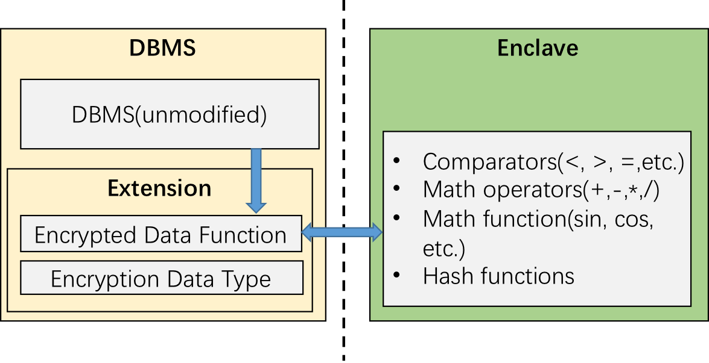
Designs offering basic protections
CryptDB^{[1]} adopts SQL-aware encryption schemes
StealthDB^{[2]} leverages Intel SGX
Provide confidentiality as extension features to legacy DBMS
Use enclave-based functions (e.g., <, >, =) for ciphertext operations
Non-intrusive design, and legacy compatible
[1] Popa. R. etl al. CryptDB: A Practical Encrypted Relational DBMS. SOSP 2011
[2] Vinayagamurthy, D. et al. StealthDB: a Scalable Encrypted Database with Full SQL Query Support. S 2019

Slide 39
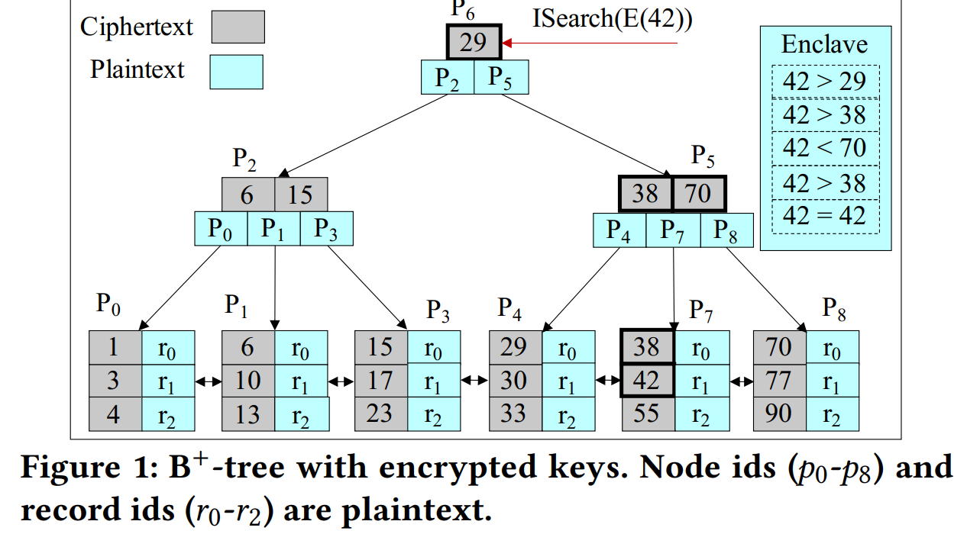
Designs offering basic protections
CryptDB^{[1]} adopts SQL-aware encryption schemes
StealthDB^{[2]} leverages Intel SGX
Pointers in the index are in plaintext
Expose the order of ciphertexts in the index, strength degraded to OPE
[1] Popa. R. etl al. CryptDB: A Practical Encrypted Relational DBMS. SOSP 2011
[2] Vinayagamurthy, D. et al. StealthDB: a Scalable Encrypted Database with Full SQL Query Support. S 2019

Slide 40
Designs offering basic protections
CryptDB^{[1]} adopts SQL-aware encryption schemes
StealthDB^{[2]} leverages Intel SGX
Pointers in the index are in plaintext
Since they are ordered in the index, ciphertexts in the index degrade to the OPE ones
Vulnerable to snapshot adversaries!
[1] Popa. R. etl al. CryptDB: A Practical Encrypted Relational DBMS. SOSP 2011
[2] Vinayagamurthy, D. et al. StealthDB: a Scalable Encrypted Database with Full SQL Query Support. S 2019

Slide 41
The Evolution of EDBs
PRZB11-CryptDB, VGG19-StealthDB
Crypto primitives
Mathematical foundations
Designs offering basic protections
Non-intrusive
IKK12, NKW15, KKNO16
Trusted Hardware
Attacks exhibit extremely high risks against snapshot adv
Better performance and functionalities
Protections against snapshot adversaries
PVC⁺18-EnclaveDB, PBP19-Arx, AAS+20-AzureAE

Slide 42
Protections against snapshot adversaries
Arx: a purely crypto EDB design without PPE schemes^{[1]}
Using semantically secure encryption to encrypt each column
Adversaries who capture a snapshot of memory or external storage will not compromise data confidentiality
Query execution will only expose matching entries (rows) rather than the entire column
[1] Poddar R. et al. Arx: An Encrypted Database using Semantically Secure Encryption. VLDB 2019

Slide 43
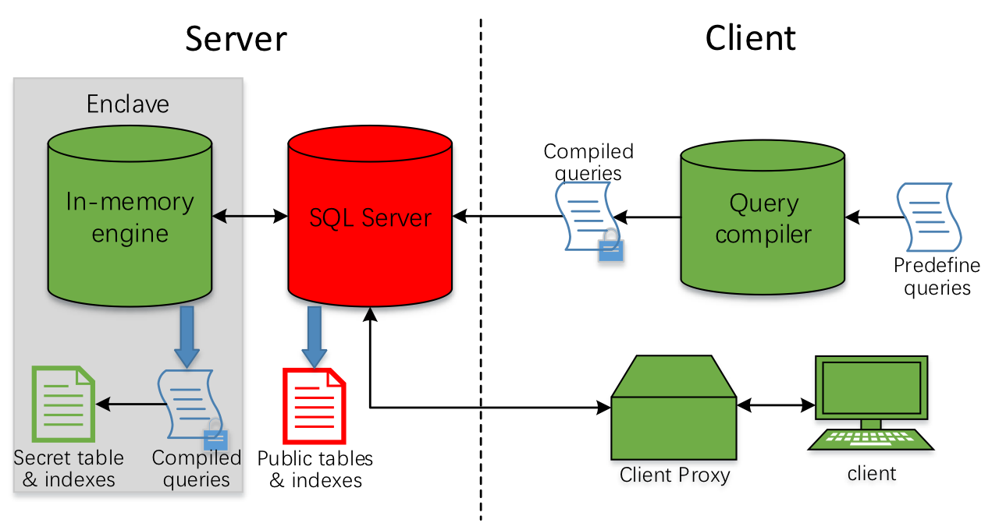
Protections against snapshot adversaries
Arx: a purely crypto EDB design without PPE schemes^{[1]}
EnclaveDB: a secure database using SGX^{[2]}
Implement an in-memory storage and query engine inside enclave
Expect systems that availably support huge enclaves (of the order of several hundred gigabytes), e.g., SGX v2
[1] Poddar R. et al. Arx: An Encrypted Database using Semantically Secure Encryption. VLDB 2019
[2] Priebe C. et al. EnclaveDB: A secure database using SGX. S&P 2018

Slide 44
Protections against snapshot adversaries
Arx: a purely crypto EDB design without PPE schemes^{[1]}
EnclaveDB: a secure database using SGX^{[2]}
Selected other designs
Microsoft Azure Always Encrypted SQL Server^{[3]}
Version 1 is based on CryptDB and hence vulnerable to snapshot adversaries
Version 2 is enhanced to be somewhat similar to EnclaveDB
EncDBDB: Searchable Encrypted, Fast, Compressed, In-Memory Database using Enclaves^{[4]}
……
[1] Poddar R. et al. Arx: An Encrypted Database using Semantically Secure Encryption. VLDB 2019
[2] Priebe C. et al. EnclaveDB: A secure database using SGX. S&P 2018
[3] Antonopoulos P. et al. Azure SQL Database Always Encrypted. In Proceedings of the 2020 ACM SIGMOD International Conference on Management of Data (SIGMOD’20),
[4] Jinwei Zhu, Kun Cheng, Jiayang Liu, and Liang Guo. 2021. Full encryption: an end to end encryption mechanism in GaussDB. Proc. VLDB Endow. 14, 12 (July 2021), 2811–2814.

Slide 45
Protections against snapshot adversaries
Arx: a purely crypto EDB design without PPE schemes^{[1]}
EnclaveDB: a secure database using SGX^{[2]}
Selected other designs
No sensitive information is leaked before queries
[1] Poddar R. et al. Arx: An Encrypted Database using Semantically Secure Encryption. VLDB 2019
[2] Priebe C. et al. EnclaveDB: A secure database using SGX. S&P 2018

Slide 46
Protections against snapshot adversaries
Arx: a purely crypto EDB design without PPE schemes^{[1]}
EnclaveDB: a secure database using SGX^{[2]}
Selected other designs
No sensitive information is leaked before queries
Information leakage during the query execution?
[1] Poddar R. et al. Arx: An Encrypted Database using Semantically Secure Encryption. VLDB 2019
[2] Priebe C. et al. EnclaveDB: A secure database using SGX. S&P 2018

Slide 47

Example
How access pattern leaks vital information
Note that each write will re-encrypt the ciphertext with a probabilistic cryptosystem
SELECT enc_count(#Days) FROM EncDay WHERE #Days=xqr143r4
EncDay
Output
Patient ID | #Days
Patient 1 | 467xt2J23t
Patient 2 | b3ecMe5Ny
Patient 3 | 42wBrfQ7yn
Patient 4 | DzcTIBBacV
Patient 5 | fNewgCgM20
Patient 6 | exXHwBh5A
Patient 7 | Scodi53gDF
Patient 8 | qOeCzC3JB
Patient 9 | zt1NEtbkn9
Patient 10 | y8158WW5
Patient 11 | iGdjPfVV3O
Patient 12 | 4WELYrlTjb
Patient 13 | j0th0LeIsP
$$Enc(0)$$
Number of days patient stays in hospital

Slide 48

Example
How access pattern leaks vital information
Note that each write will re-encrypt the ciphertext with a probabilistic cryptosystem
SELECT enc_count(#Days) FROM EncDay WHERE #Days=xqr143r4
EncDay
Output
Patient ID | #Days
Patient 1 | 467xt2J23t
Patient 2 | b3ecMe5Ny
Patient 3 | 42wBrfQ7yn
Patient 4 | DzcTIBBacV
Patient 5 | fNewgCgM20
Patient 6 | exXHwBh5A
Patient 7 | Scodi53gDF
Patient 8 | qOeCzC3JB
Patient 9 | zt1NEtbkn9
Patient 10 | y8158WW5
Patient 11 | iGdjPfVV3O
Patient 12 | 4WELYrlTjb
Patient 13 | j0th0LeIsP
$$Enc(1)$$
Number of days patient stays in hospital

Slide 49
Example
How access pattern leaks vital information
Note that each write will re-encrypt the ciphertext with a probabilistic cryptosystem
SELECT enc_count(#Days) FROM EncDay WHERE #Days=xqr143r4
EncDay
Output
Patient ID | #Days
Patient 1 | 467xt2J23t
Patient 2 | b3ecMe5Ny
Patient 3 | 42wBrfQ7yn
Patient 4 | DzcTIBBacV
Patient 5 | fNewgCgM20
Patient 6 | exXHwBh5A
Patient 7 | Scodi53gDF
Patient 8 | qOeCzC3JB
Patient 9 | zt1NEtbkn9
Patient 10 | y8158WW5
Patient 11 | iGdjPfVV3O
Patient 12 | 4WELYrlTjb
Patient 13 | j0th0LeIsP
$$Enc(1)$$
Number of days patient stays in hospital

Slide 50

Example
How access pattern leaks vital information
Note that each write will re-encrypt the ciphertext with a probabilistic cryptosystem
SELECT enc_count(#Days) FROM EncDay WHERE #Days=xqr143r4
EncDay
Output
Patient ID | #Days
Patient 1 | 467xt2J23t
Patient 2 | b3ecMe5Ny
Patient 3 | 42wBrfQ7yn
Patient 4 | DzcTIBBacV
Patient 5 | fNewgCgM20
Patient 6 | exXHwBh5A
Patient 7 | Scodi53gDF
Patient 8 | qOeCzC3JB
Patient 9 | zt1NEtbkn9
Patient 10 | y8158WW5
Patient 11 | iGdjPfVV3O
Patient 12 | 4WELYrlTjb
Patient 13 | j0th0LeIsP
$$Enc(2)$$
Number of days patient stays in hospital

Slide 51
Example
How access pattern leaks vital information
Note that each write will re-encrypt the ciphertext with a probabilistic cryptosystem
SELECT enc_count(#Days) FROM EncDay WHERE #Days=xqr143r4
EncDay
Output
Patient ID | #Days
Patient 1 | 467xt2J23t
Patient 2 | b3ecMe5Ny
Patient 3 | 42wBrfQ7yn
Patient 4 | DzcTIBBacV
Patient 5 | fNewgCgM20
Patient 6 | exXHwBh5A
Patient 7 | Scodi53gDF
Patient 8 | qOeCzC3JB
Patient 9 | zt1NEtbkn9
Patient 10 | y8158WW5
Patient 11 | iGdjPfVV3O
Patient 12 | 4WELYrlTjb
Patient 13 | j0th0LeIsP
$$Enc(2)$$
Number of days patient stays in hospital

Slide 52
Example
How access pattern leaks vital information
Note that each write will re-encrypt the ciphertext with a probabilistic cryptosystem
SELECT enc_count(#Days) FROM EncDay WHERE #Days=xqr143r4
EncDay
Output
Patient ID | #Days
Patient 1 | 467xt2J23t
Patient 2 | b3ecMe5Ny
Patient 3 | 42wBrfQ7yn
Patient 4 | DzcTIBBacV
Patient 5 | fNewgCgM20
Patient 6 | exXHwBh5A
Patient 7 | Scodi53gDF
Patient 8 | qOeCzC3JB
Patient 9 | zt1NEtbkn9
Patient 10 | y8158WW5
Patient 11 | iGdjPfVV3O
Patient 12 | 4WELYrlTjb
Patient 13 | j0th0LeIsP
$$Enc(2)$$
Number of days patient stays in hospital

Slide 53

Example
How access pattern leaks vital information
Note that each write will re-encrypt the ciphertext with a probabilistic cryptosystem
SELECT enc_count(#Days) FROM EncDay WHERE #Days=xqr143r4
EncDay
Output
Patient ID | #Days
Patient 1 | 467xt2J23t
Patient 2 | b3ecMe5Ny
Patient 3 | 42wBrfQ7yn
Patient 4 | DzcTIBBacV
Patient 5 | fNewgCgM20
Patient 6 | exXHwBh5A
Patient 7 | Scodi53gDF
Patient 8 | qOeCzC3JB
Patient 9 | zt1NEtbkn9
Patient 10 | y8158WW5
Patient 11 | iGdjPfVV3O
Patient 12 | 4WELYrlTjb
Patient 13 | j0th0LeIsP
$$Enc(7)$$
Number of days patient stays in hospital
7 out of 13 write to the output variable

Slide 54
Example
How access pattern leaks vital information
Note that each write will re-encrypt the ciphertext with a probabilistic cryptosystem
SELECT enc_count(#Days) FROM EncDay WHERE #Days=xqr143r4
EncDay
Output
EncDay
Patient ID | #Days
Patient 1 | 467xt2J23t
Patient 2 | b3ecMe5Ny
Patient 3 | 42wBrfQ7yn
Patient 4 | DzcTIBBacV
Patient 5 | fNewgCgM20
Patient 6 | exXHwBh5A
Patient 7 | Scodi53gDF
Patient 8 | qOeCzC3JB
Patient 9 | zt1NEtbkn9
Patient 10 | y8158WW5
Patient 11 | iGdjPfVV3O
Patient 12 | 4WELYrlTjb
Patient 13 | j0th0LeIsP
$$Enc(7)$$
Patient ID | #Days
Patient 1 | 1
Patient 2 | b3ecMe5Ny
Patient 3 | 1
Patient 4 | DzcTIBBacV
Patient 5 | fNewgCgM20
Patient 6 | 1
Patient 7 | 1
Patient 8 | qOeCzC3JB
Patient 9 | 1
Patient 10 | y8158WW5
Patient 11 | 1
Patient 12 | 4WELYrlTjb
Patient 13 | 1
Number of days patient stays in hospital
Number of days patient stays in hospital
7 out of 13 write to the output variable
Auxiliary information
#Days | Frequency
1 | 0.61
2 | 0.28
3 | 0.11

Slide 55
Example
How access pattern leaks vital information
Note that each write will re-encrypt the ciphertext with a probabilistic cryptosystem
SELECT enc_count(#Days) FROM EncDay WHERE #Days=xqr143r4
EncDay
Output
EncDay
Patient ID | #Days
Patient 1 | 467xt2J23t
Patient 2 | b3ecMe5Ny
Patient 3 | 42wBrfQ7yn
Patient 4 | DzcTIBBacV
Patient 5 | fNewgCgM20
Patient 6 | exXHwBh5A
Patient 7 | Scodi53gDF
Patient 8 | qOeCzC3JB
Patient 9 | zt1NEtbkn9
Patient 10 | y8158WW5
Patient 11 | iGdjPfVV3O
Patient 12 | 4WELYrlTjb
Patient 13 | j0th0LeIsP
$$Enc(7)$$
Patient ID | #Days
Patient 1 | 1
Patient 2 | b3ecMe5Ny
Patient 3 | 1
Patient 4 | DzcTIBBacV
Patient 5 | fNewgCgM20
Patient 6 | 1
Patient 7 | 1
Patient 8 | qOeCzC3JB
Patient 9 | 1
Patient 10 | y8158WW5
Patient 11 | 1
Patient 12 | 4WELYrlTjb
Patient 13 | 1
Number of days patient stays in hospital
Number of days patient stays in hospital
Recover the entire table after sufficient queries!
7 out of 13 write to the output variable
Auxiliary information
#Days | Frequency
1 | 0.61
2 | 0.28
3 | 0.11

Slide 56

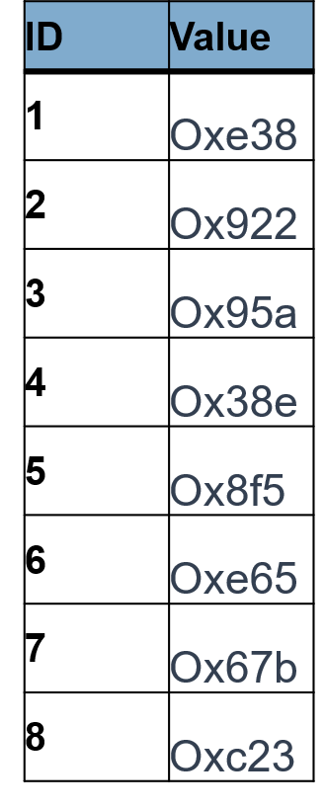

Example
Leakage from query results to persistent advs
Rather than directly observing the memory access pattern, a persistent adversary can learn the result set
Select * From table
Where value < ?;
{2,3,5,7}
M. Lacharité, et al., "Improved Reconstruction Attacks on Encrypted Data Using Range Query Leakage," IEEE SP, 2018, pp. 297-314

Slide 57
Example
Leakage from query results to persistent advs
Rather than directly observing the memory access pattern, a persistent adversary can learn the result set
Select * From table
Where value < ?;
{2,3,5,7}
{2,3,5,7,8}
M. Lacharité, et al., "Improved Reconstruction Attacks on Encrypted Data Using Range Query Leakage," 2018 IEEE SP, 2018, pp. 297-314

Slide 58

Example
Leakage from query results to persistent advs
Rather than directly observing the memory access pattern, a persistent adversary can learn the result set
Query 2
Query 1
2
8
3
7
5
1
4
6
M. Lacharité, et al., "Improved Reconstruction Attacks on Encrypted Data Using Range Query Leakage," 2018 IEEE SP, 2018, pp. 297-314

Slide 59
Example
Leakage from query results to persistent advs
Rather than directly observing the memory access pattern, a persistent adversary can learn the result set
Query 2
Query 1
<
2
8
3
7
5
1
4
6
M. Lacharité, et al., "Improved Reconstruction Attacks on Encrypted Data Using Range Query Leakage," 2018 IEEE SP, 2018, pp. 297-314

Slide 60
Leakage-abuse attacks exploiting information leakage during the query execution
M. Islam, et al., Access pattern disclosure on searchable encryption: Ramification, attack and mitigation. In NDSS 2012.
D. Cash, et al., Leakage-abuse attacks against searchable encryption. In CCS 2015.
M. Lacharité, et al., Improved Reconstruction Attacks on Encrypted Data Using Range Query Leakage. In S&P 2018.
P. Grubbs, et al. Pump up the volume: Practical database reconstruction from volume leakage on range queries. In CCS 2018.
P. Grubbs, et al. Learning to reconstruct: Statistical learning theory and encrypted database attacks. In S&P 2019.
Z. Gui, et al. Encrypted databases: New volume attacks against range queries. In CCS 2019.
L. Blackstone, et al. Revisiting leakage abuse attacks. In NDSS 2020.
E. Kornaropoulos, et al. The state of the uniform: Attacks on encrypted databases beyond the uniform query distribution. In S&P 2020.
E. Kornaropoulos, et al. Response-hiding encrypted ranges: Revisiting security via parametrized leakage-abuse attacks. In S&P 2021.
S. Oya, et al. Hiding the access pattern is not enough: Exploiting search pattern leakage in searchable encryption. In USENIX Security 2021.
…

Slide 61
Cannot ignore the leakage during the EDB operations
Data is highly sensitive
Persistent adversaries may exist
An ORDER BY query execution (takes a few millisecond) leaks the exact order of ciphertexts

Slide 62
The Evolution of EDBs
PRZB11-CryptDB, VGG19-StealthDB
Crypto primitives
Mathematical foundations
Designs offering basic protections
Non-intrusive
IKK12, NKW15, KKNO16
Trusted Hardware
Attacks exhibit extremely high risks against snapshot adv
Better performance and functionalities
(G)LMP18, GJW19, BKM20, KPT20, OK21
Protections against snapshot adversaries
Numerous devastating attacks exploiting access pattern leakage (plus other leakage)
PVC⁺18-EnclaveDB, PBP19-Arx, AAS+20-AzureAE
Full protections against persistent adversaries
ZDB⁺17-Opaque, MPC⁺19-Oblix
HOJY19-POSUP, EZ19-ObliDB

Slide 63
Why do we need access pattern protection?
Input data
affect
Memory pages accessed
infer
auxiliary information

Slide 64
What does obliviousness mean?
Independent
Input data
Memory pages accessed

Slide 65
How to achieve obliviousness
Leverage existing general-purpose extensions^{[1, 2]} to offer ORAM inside enclaves
Not satisfactory efficiency (compared to later designs)
Only focus on access pattern leakage (other leakage patterns such as result size, aka volume leakage, not protected)
[1] S. Sasy, S. Gorbunov, and C. W. Fletcher. Zerotrace : Oblivious memory primitives from Intel SGX. ePrint 2017/549, 2017. http://eprint.iacr.org/ 2017/549.
[2] OBLIVIATE: A Data Oblivious Filesystem for Intel SGX. NDSS 2018

Slide 66
How to achieve obliviousness
Leverage existing general-purpose extensions^{[1, 2]} to offer ORAM inside enclaves
Customized algorithms to offer obliviousness for different workloads in databases
Oblivious indexes^{[1, 2, 3]}
Selection^{[4, 5, 6]}
Table joins, groups, etc^{.[6]}
[1] P. Mishra, R. Poddar, J. Chen, A. Chiesa and R. A. Popa, "Oblix: An Efficient Oblivious Search Index," 2018 IEEE Symposium on Security and Privacy (SP), 2018, pp. 279-296.
[2] Hoang, T., Ozmen, M.O., Jang, Y., & Yavuz, A.A. Hardware-Supported ORAM in Effect: Practical Oblivious Search and Update on Very Large Dataset. PETS, 2019, 172 - 191.
[3] D. S. Roche, A. J. Aviv, and S. G. Choi. A practical oblivious map data structure with secure deletion and history independence. In IEEE SP 2016, 2016, pages 178–197, 2016.
[4] A. Arasu, S. Blanas, K. Eguro, R. Kaushik, D. Kossmann, R. Ramamurthy, and R. Venkatesan. Orthogonal security with cipherbase. In CIDR 2013.
[5] W. Zheng, A. Dave, J. G. Beekman, R. A. Popa, J. E. Gonzalez, and I. Stoica. Opaque: An oblivious and encrypted distributed analytics platform. In NSDI 2017.
[6] S. Eskandarian, M. Zaharia. ObliDB: Oblivious Query Processing for Secure Databases. VLDB2019.

Slide 67

Cost of being obliviousness
A theoretical lower bound: $Ω\left(\log{n}\right)$ multiplicative overheads^{[1]}
$n$ is the number of records
hundreds of times cost amplification for millions of records
E.g., the point query over a table with ${10}^{6}$ rows^{[2]}
${10}^{−5}\sim {10}^{−4}$ seconds→ ${10}^{−3}\sim {10}^{−2}$ seconds
Already SOTA results
[1] Goldreich O, Ostrovsky R (1996) Software protection and simulation on oblivious RAMs. J ACM 43(3):431–473
[2] S. Eskandarian, M. Zaharia. ObliDB: Oblivious Query Processing for Secure Databases. VLDB2019.

Slide 68
Rethink about full obliviousness
Independent
Input data
Memory pages accessed
Is this really necessary?

Slide 69

Requirements for successful attacks?
A successful attack demands sufficient leakage take range queries as an example
Assume no access pattern protection, queries are uniformly random
Some lower bounds (impossibilities) on the number of queries to launch an attack
≥ $Ω\left(n^{4}\right)$ queries to fully recover a database^{[1]}
≥ $\frac{1}{2}n⋅\log{n}−O\left(n\right)$ queries in dense databases^{[2]}
≥ $Ω\left(ε^{−2}\right)$ queries to approximately recover ciphertext by ignoring a small portion of records from both ends, where $ε$ is the error rate^{[3]}
[1] G. Kellaris, G. Kollios, K. Nissim, and A. O’Neill, “Generic attacks on secure outsourced databases,” in CCS, 2016
[2] M.-S. Lacharite, B. Minaud, and K. G. Paterson, “Improved reconstruction attacks on encrypted data using range query leakage,” in 2018 IEEE S&P, May 2018, pp. 297–314.
[3] P. Grubbs, M. Lacharité, B. Minaud and K. G. Paterson, "Learning to Reconstruct: Statistical Learning Theory and Encrypted Database Attacks," 2019 IEEE S&P, 2019, pp. 1067-1083

Slide 70

Requirements for successful attacks?
A successful attack demands sufficient leakage take range queries as an example
Assume no access pattern protection, queries are uniformly random
Some lower bounds (impossibilities) on the number of queries to launch an attack
≥ $Ω\left(n^{4}\right)$ queries to fully recover a database^{[1]}
≥ $\frac{1}{2}n⋅\log{n}−O\left(n\right)$ queries in dense databases^{[2]}
≥ $Ω\left(ε^{−2}\right)$ queries to approximately recover ciphertext by ignoring a small portion of records from both ends, where $ε$ is the error rate^{[3]}
Computational hardness assumptions
There are many hardness assumptions we may take advantages of
Planted densest subgraph problem to hide volume pattern^{[4]}
[1] G. Kellaris, G. Kollios, K. Nissim, and A. O’Neill, “Generic attacks on secure outsourced databases,” in CCS, 2016
[2] M.-S. Lacharite, B. Minaud, and K. G. Paterson, “Improved reconstruction attacks on encrypted data using range query leakage,” in 2018 IEEE S&P, May 2018, pp. 297–314.
[3] P. Grubbs, M. Lacharité, B. Minaud and K. G. Paterson, "Learning to Reconstruct: Statistical Learning Theory and Encrypted Database Attacks," 2019 IEEE S&P, 2019, pp. 1067-1083
[4] Seny Kamara and Tarik Moataz. Computationally volume-hiding structured encryption. EuroCrypt 2019.

Slide 71
The Evolution of EDBs
PRZB11-CryptDB, VGG19-StealthDB
Crypto primitives
Mathematical foundations
Designs offering basic protections
Non-intrusive
IKK12, NKW15, KKNO16
Trusted Hardware
Attacks exhibit extremely high risks against snapshot adv
Better performance and functionalities
(G)LMP18, GJW19, BKM20, KPT20, OK21
Protections against snapshot adversaries
Numerous devastating attacks exploiting access pattern leakage (plus other leakage)
PVC⁺18-EnclaveDB, PBP19-Arx, AAS+20-AzureAE
KKNO16, GLMP18
Limitations on adversary capabilities
Full protections against persistent adversaries
Recent attempts to balance security and performance
Theoretically and empirically unscalable
ZDB⁺17-Opaque, MPC⁺19-Oblix
HOJY19-POSUP, EZ19-ObliDB
GKL⁺20-Pancake
XDZ⁺21, SOPK21^
SWLL21-Enclage
VBKA22-Shortstack
GO96, EZ19-ObliDB

Slide 72
Recent attempts to
balance security and performance
Smooth the access frequency of items^{[1]}
In previous CryptDB example, an adversary can distinguish ciphertexts since they have distinct access frequency
Hide such distinguishing features at a reasonable cost of
keeping states in the client proxy
Extra storage and communication resources
[1] Grubbs, P. et al. Pancake: Frequency Smoothing for encrypted data stores. USENIX Security 2020.

Slide 73
Recent attempts to
balance security and performance
Smooth the access frequency of items^{[1]}
In previous CryptDB example, an adversary can distinguish ciphertexts since they have distinct access frequency
Hide such distinguishing features at a reasonable cost of
keeping states in the client proxy
Extra storage and communication resources
Node-level access policy^{[2]}
Guarantee obliviousness under a small granularity
Lack mathematical analysis between the oblivious granularity and the security level
[1] Grubbs, P. et al. Pancake: Frequency Smoothing for encrypted data stores. USENIX Security 2020.
[2] Yuanyuan Sun, Sheng Wang, Huorong Li, and Feifei Li. 2021. Building enclave-native storage engines for practical encrypted databases. Proc. VLDB Endow. 14, 6 (February 2021), 1019–1032.

Slide 74
Recent attempts to
balance security and performance
Smooth the access frequency of items^{[1]}
In previous CryptDB example, an adversary can distinguish ciphertexts since they have distinct access frequency
We hide such distinguishing features at a reasonable cost of
keeping some states in the client proxy
Extra storage and communication resources
Node-level access policy^{[2]}
Guarantee obliviousness under a small granularity
Lack mathematical analysis between the oblivious granularity and the security level
Obfuscate access pattern via differential privacy^{[3, 4]}
Threat access pattern as a kind of statistics to be released, and apply DP tools to obfuscate individual privacy
[1] Grubbs, P. et al. Pancake: Frequency Smoothing for encrypted data stores. USENIX Security 2020.
[2] Yuanyuan Sun, Sheng Wang, Huorong Li, and Feifei Li. 2021. Building enclave-native storage engines for practical encrypted databases. Proc. VLDB Endow. 14, 6 (February 2021), 1019–1032.
[3] Z. Shang, S. Oya, et al. Obfuscated Access and Search Patterns in Searchable Encryption. NDSS 2022.
[4] L. Xu, et al. Interpreting and Mitigating Leakage-Abuse Attacks in Searchable Symmetric Encryption. TIFS 201.

Slide 75
The Evolution of EDBs
PRZB11-CryptDB, VGG19-StealthDB
Crypto primitives
Mathematical foundations
Designs offering basic protections
Non-intrusive
IKK12, NKW15, KKNO16
Trusted Hardware
Attacks exhibit extremely high risks against snapshot adv
Better performance and functionalities
(G)LMP18, GJW19, BKM20, KPT20, OK21
Protections against snapshot adversaries
Numerous devastating attacks exploiting access pattern leakage (plus other leakage)
PVC⁺18-EnclaveDB, PBP19-Arx, AAS+20-AzureAE
Future directions
KKNO16, GLMP18
Limitations on adversary capabilities
Full protections against persistent adversaries
Recent attempts to balance security and performance
Theoretically and empirically unscalable
ZDB⁺17-Opaque, MPC⁺19-Oblix
HOJY19-POSUP, EZ19-ObliDB
GKL⁺20-Pancake
XDZ⁺21, SOPK21^
SWLL21-Enclage
VBKA22-Shortstack
GO96, EZ19-ObliDB

Slide 76
Possible future roadmaps
Provide EDB designs with reasonable and controllable information leakage
Establish a qualitative and quantitative risk assessment framework for encrypted database in operation
Monitoring the ever-accumulating leakage profiles (per query) is important
Assess associated risks and take actions accordingly

Slide 77
Possible future roadmaps
Provide EDB designs with reasonable and controllable information leakage
Establish a qualitative and quantitative risk assessment framework for encrypted database in operation
Monitoring the ever-accumulating leakage profiles (per query) is important
Assess associated risks and take actions accordingly
Thank you! Questions?

